Slide 1
UNIT 5 NLP Applications

Slide 2
What is Chatbot?
A chatbot (conversational interface, AI agent) is a computer program that can understand human language and converse with a user via a website or a messaging app.
Chatbots can handle various tasks online — from answering simple questions and scheduling calls to gathering customer feedback. Brands use bots to automate their business processes, speed up customer service, and lower support costs.
Not all chatbots are equipped with artificial intelligence (AI), but modern chatbots increasingly use conversational AI techniques such as natural language processing (NLP) to understand user questions and automate responses to them.

Slide 3
The Evolution of Chatbots
The evolution of chatbots represents a charming journey via the annals of AI and human-computer interplay.
Over the years, chatbots have undergone a remarkable transition, evolving from its basic text-based programs to sophisticated digital assistants with natural language and context recognition.
This history reflects the convergence of scientific discoveries, technology advancements, and practical worldwide programs, and it echoes the unrelenting quest to replicate human-like conversational abilities in machines
1. Eliza
2. Parry
3. The Jabberwacky
4. A. L. I. C. E
5. SmarterChild
6. Google Assistance
8. ChatGPT

Slide 4
Types of Chatbots

Slide 5
Limitations of Chatbots
Lack of Understanding: Chatbots may also struggle to recognize complicated queries or nuances in language, which leads to misunderstandings.
Limited Scope: They are powerful as their programmed abilties, restricting their ability to handle unforeseen data.
Impersonal Interactions: Some customers may also decide on human interplay over interacting with a system, leading to dissatisfaction.
Technical Issues: Chatbots are prone to technical system faults and errors, that can disrupt consumer reports.
Dependency: Overreliance on chatbots may result in reduced human interaction and lack of interpersonal connections.
Initial Investment: Developing and imposing chatbots requires preliminary investment in phrases of time, resources, and technical kmowledge.
Maintenance: Chatbots require ongoing protection and updates to stay powerful and relevant through the years.

Slide 6
What is Information Extraction?
Text data contains a plethora of information, yet not all of it may be relevant to your needs. Some may seek to extract specific relationships between entities, utilizing information extraction NLP techniques. Our intentions vary based on individual requirements and objectives.
Imagine having to go through all the legal documents to find legal precedence to validate your current case. Or having to go through all the research papers to find relevant information to cure a disease. There are many more examples like resume harvesting, media analysis, email scanning, etc.
But just imagine having to manually go through all of the textual data and extracting the most relevant information. Clearly, it is an uphill battle and you might even end up skipping some important information.

Slide 7
For anyone trying to analyze textual data, the difficult task is not of finding the right documents, but of finding the right information from these documents. Understanding the relationship between entities, understanding how the events have unfolded, or just simply finding hidden gems of information, is clearly what anyone is looking for when they go through a piece of text.
Therefore, coming up with an automated way of extracting the information from textual data and presenting it in a structured manner will help us reap a lot of benefits and tremendously reduce the amount of time we have to spend time skimming through text documents. This is precisely what information extraction strives to achieve.

Slide 8
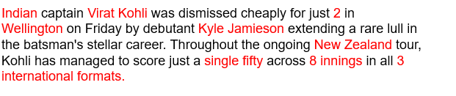
The task of Information Extraction (IE) involves extracting meaningful information from unstructured text data and presenting it in a structured format.
Using information extraction nlp, we can retrieve pre-defined information such as the name of a person, location of an organization, or identify a relation between entities, and save this information in a structured format such as a database.
Let me show you another example I’ve taken from a cricket news article:

Slide 9
We can extract the following information from the text:
Country – India, Captain – Virat Kohli
Batsman – Virat Kohli, Runs – 2
Bowler – Kyle Jamieson
Match venue – Wellington
Match series – New Zealand
Series highlight – single fifty, 8 innings, 3 formats
This enables us to reap the benefits of powerful query tools like SQL for further analysis. Creating such structured data using information extraction will not only help us in analyzing the documents better but also help us in understanding the hidden relationships in the text.

Slide 10
How Does Information Extraction Work?
Given the capricious nature of text data that changes depending on the author or the context, Information Extraction seems like a daunting task. But it doesn’t have to be that way!
We all know that sentences are made up of words belonging to different Parts of Speech (POS). There are eight different POS in the English language: noun, pronoun, verb, adjective, adverb, preposition, conjunction, and intersection.
The POS determines how a specific word functions in meaning in a given sentence. For example, take the word “right”. In the sentence, “The boy was awarded chocolate for giving the right answer”, “right” is used as an adjective. Whereas, in the sentence, “You have the right to say whatever you want”, “right” is treated as a noun.
This goes to show that the POS tag of a word carries a lot of significance when it comes to understanding the meaning of a sentence. And we can leverage it to extract meaningful information from our text.

Slide 11
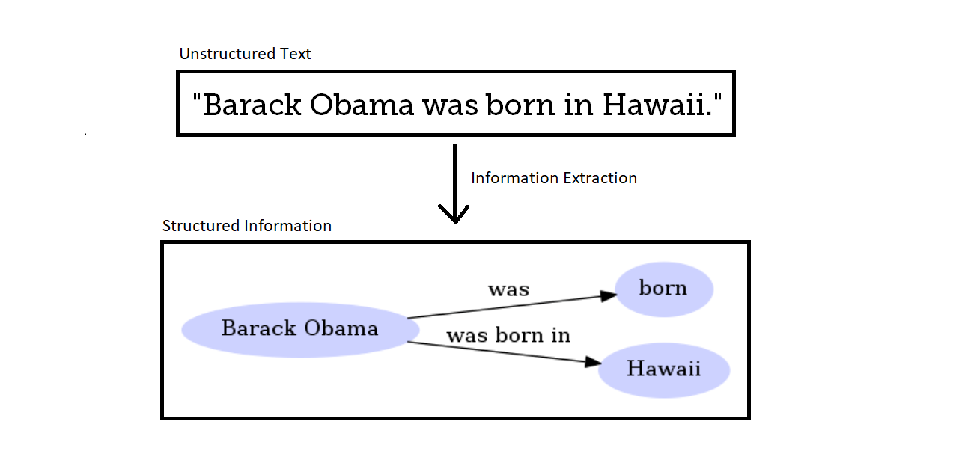
Information extraction (IE)
The task of automatically extracting structured information from unstructured and/or semi-structured machine-readable documents and other electronically represented sources is known as information extraction (IE).
When there are a significant number of customers, manually assessing Customer Feedback, for example, can be tedious, error-prone, and time-consuming. There's a good chance we'll overlook a dissatisfied consumer. Fortunately, sentiment analysis can aid in the improvement of customer support interactions' speed and efficacy. By doing sentiment analysis on all the incoming tickets and prioritizing them above the others, one can quickly identify the most dissatisfied customers or the most important issues. One might also allocate tickets to the appropriate individual or team to handle them. As a result, Consumer satisfaction will improve dramatically.

Slide 12
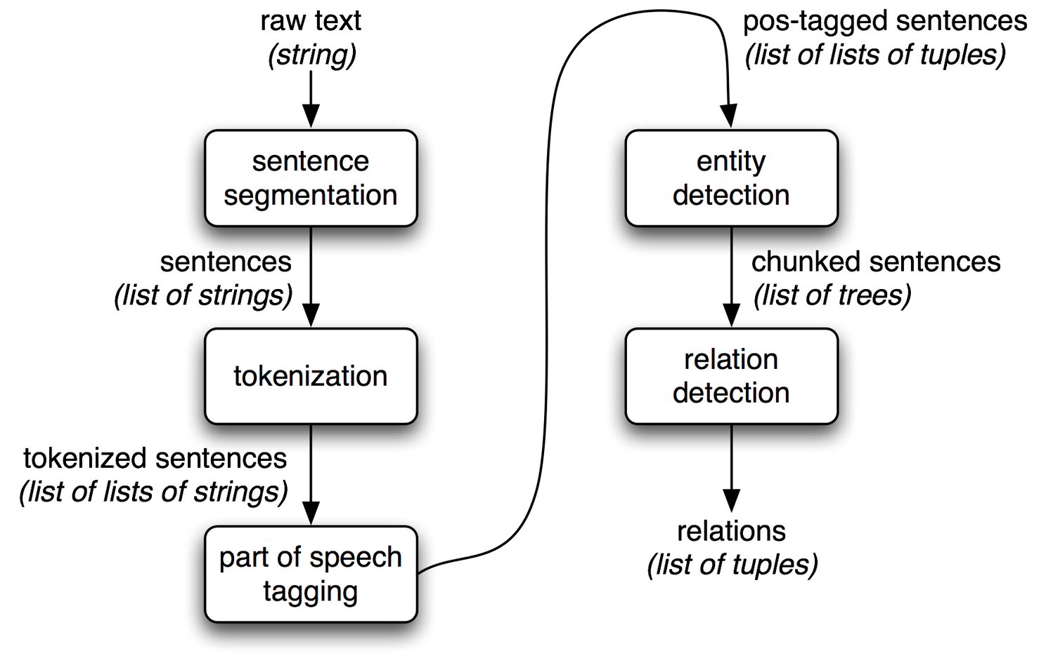
General Pipeline of the Information Extraction Process
The following steps are often involved in extracting structured information from unstructured texts:
1. Initial processing.
2. Proper names identification.
3. Parsing.
4. Extraction of events and relations.
5. Anaphora resolution.
6. Output result generation.

Slide 13
1. Initial processing
The first step is to break down a text into fragments such as zones, phrases, segments, and tokens. This function can be performed by tokenizers, text zoners, segmenters, and splitters, among other components. In the initial processing stage, part-of-speech tagging, and phrasal unit identification (noun or verb phrases) are usually the next tasks.
2. Proper names identification
One of the most important stages in the information extraction chain is the identification of various classes of proper names, such as names of people or organizations, dates, monetary amounts, places, addresses, and so on. They may be found in practically any sort of text and are widely used in the extraction process. Regular expressions, which are a collection of patterns, are used to recognize these names.

Slide 14
3. Parsing
The syntactic analysis of the sentences in the texts is done at this step. After recognizing the fundamental entities in the previous stage, the sentences are processed to find the noun groups that surround some of those entities and verb groups. At the pattern matching step, the noun and verb groupings are utilized as sections to begin working on.
4. Extraction of events and relations
This stage establishes relations between the extracted ideas. This is accomplished by developing and implementing extraction rules that describe various patterns. The text is compared to certain patterns, and if a match is discovered, the text element is labeled and retrieved later.
5. Coreference or Anaphora resolution
Coreference resolution is used to identify all of the ways the entity is named throughout the text. The step where noun phrases are decided if they relate to the same entity or not is called coreference or anaphora resolution.
6. Output results generation
This stage entails converting the structures collected during the preceding processes into output templates that follow the format defined by the user. It might comprise a variety of normalization processes.

Slide 15
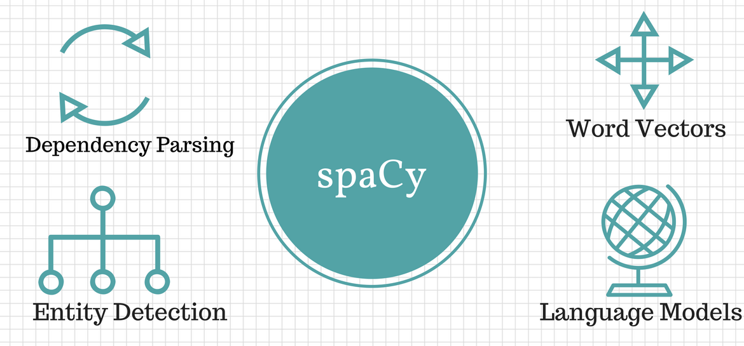
Information Extraction Techniques Using Natural Language Processing
1. Regular Expression.
2. Part-of-speech tagging.
3. Named Entity Recognition.
4. Topic Modeling.
5. Rule-Based Matching.

Slide 16
NLP - Information Retrieval
Information retrieval (IR) may be defined as a software program that deals with the organization, storage, retrieval and evaluation of information from document repositories particularly textual information.
The system assists users in finding the information they require but it does not explicitly return the answers of the questions. It informs the existence and location of documents that might consist of the required information.
The documents that satisfy user’s requirement are called relevant documents.
A perfect IR system will retrieve only relevant documents.

Slide 17
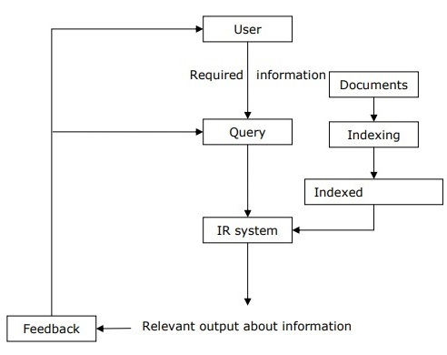
It is clear from the diagram that a user who needs information will have to formulate a request in the form of query in natural language. Then the IR system will respond by retrieving the relevant output, in the form of documents, about the required information.

Slide 18
Classical Problem in Information Retrieval (IR) System
The main goal of IR research is to develop a model for retrieving information from the repositories of documents. Here, we are going to discuss a classical problem, named ad-hoc retrieval problem, related to the IR system.
In ad-hoc retrieval, the user must enter a query in natural language that describes the required information. Then the IR system will return the required documents related to the desired information. For example, suppose we are searching something on the Internet and it gives some exact pages that are relevant as per our requirement but there can be some non-relevant pages too. This is due to the ad-hoc retrieval problem.

Slide 19
Types of Information Retrieval (IR) Model
Classical IR Model
It is the simplest and easy to implement IR model. This model is based on mathematical knowledge that was easily recognized and understood as well. Boolean, Vector and Probabilistic are the three classical IR models.
Non-Classical IR Model
It is completely opposite to classical IR model. Such kind of IR models are based on principles other than similarity, probability, Boolean operations. Information logic model, situation theory model and interaction models are the examples of non-classical IR model.
Alternative IR Model
It is the enhancement of classical IR model making use of some specific techniques from some other fields. Cluster model, fuzzy model and latent semantic indexing (LSI) models are the example of alternative IR model.

Slide 20
Design features of Information retrieval (IR) systems
Inverted Index
The primary data structure of most of the IR systems is in the form of inverted index. We can define an inverted index as a data structure that list, for every word, all documents that contain it and frequency of the occurrences in document. It makes it easy to search for ‘hits’ of a query word.
Stop Word Elimination
Stop words are those high frequency words that are deemed unlikely to be useful for searching. They have less semantic weights. All such kind of words are in a list called stop list. For example, articles “a”, “an”, “the” and prepositions like “in”, “of”, “for”, “at” etc. are the examples of stop words. The size of the inverted index can be significantly reduced by stop list. As per Zipf’s law, a stop list covering a few dozen words reduces the size of inverted index by almost half. On the other hand, sometimes the elimination of stop word may cause elimination of the term that is useful for searching. For example, if we eliminate the alphabet “A” from “Vitamin A” then it would have no significance.
Stemming
Stemming, the simplified form of morphological analysis, is the heuristic process of extracting the base form of words by chopping off the ends of words. For example, the words laughing, laughs, laughed would be stemmed to the root word laugh.
In our subsequent sections, we will discuss about some important and useful IR models.

Slide 21
Semantic Search and Evaluation
Semantic search means understanding the intent behind the query and representing the “knowledge in a way suitable for meaningful retrieval,” according to Towards Data Science.
Semantic search is a search technique that uses natural language processing (NLP) and machine learning (ML) to understand the context and meaning behind a user's search query.

Slide 22
What is a Semantic Search Engine?
A Semantic Search Engine (sometimes called a Vector Database) is specifically designed to conduct a semantic similarity search.
Semantic Search Engines will use a specific index algorithm to build an index of a set of vector embeddings. Milvus has 11 different Index options, but most Semantic Search Engines only have one (typically HNSW).
With the Index and similarity metrics, users can query for similar items with the Semantic Search Engine.

Slide 23
Keyword Search Vs Semantic Search
At first, search engines were lexical: the search engine looked for literal matches of the query words, without understanding of the query’s meaning and only returning links that contained the exact query.
By using regular keyword search, a document either contains the given word or not, and there is no middle ground
On the other hand, “Semantic Search” can simplify query building, because it is supported by automated natural language processing programs i.e. using Latent Semantic Indexing — a concept that search engines use to discover how a keyword and content work together to mean the same thing.

Slide 24
How to Implement a Semantic Search Engine?
There are several options to implement Semantic Search. Here are a few options
Python Semantic Search Engine. You can build a custom Semantic Search on your own corpus of data using Python, a machine model, and a Vector Index Algorithm like FAISS, HNSW, or even ANNOY. Here is a tutorial to walk you through how to implement Semantic Search with Facebook AI Similarity Search (FAISS).
Traditional keyword based Search Engines like ElasticSearch also have added Vector Search capabilities. The benefit is that you can easily add vector search to a solution already using Elasticsearch.
Popular database solutions like PostgreSQL have added extensions like Pgvector to support vector search. Here is a tutorial to walk you through how to get started using Pgvector.
Vector Databases Another great option is to use a Vector Database to implement Semantic Search. With a vector database, you store and index the vector embeddings that you generate with your chosen machine learning algorithm. With most vector databases, you use HSNW to generate the index, with Milvus, you can choose from 11 different index types to best fit your use case. When you start your search, you will convert to a vector embedding then do a query against your dataset to find the most similar items.

Slide 25
Types of Semantic Search
Entity Recognition and Linking: This type recognizes entities within the text (like names, locations, products) and links them to a knowledge base or ontology. This helps in understanding the context and relations among entities.
Concept Search: Goes beyond matching keywords to understanding concepts within the text. For example, searching for "cold symptoms" might also return results related to flu or pneumonia without those exact words being present.
Lexical Affinity: Determines the association and co-occurrence frequencies of words within a corpus to infer the context and meaning, thus aiding in retrieving more relevant results.
Query Expansion: Automatically expands a user’s search query by adding synonyms or related terms to fetch broader results that still align with the user’s intent.

Slide 26
Semantic search utilizes advanced NLP techniques such as:
Word Embeddings: Vector representations of words that capture their meanings, relations, and context within a dimensional space. Tools like Word2Vec, GloVe, or BERT can be used to analyze semantic similarities between different terms.
Ontologies and Knowledge Graphs: Structured frameworks that organize information and define relationships between concepts. They help in understanding how various entities are interconnected.
Contextual Analysis: Interprets the context in which words or phrases are used. This might involve looking at surrounding text to gauge sentiment, usage, and intent.
Machine Learning and Deep Learning: Algorithms that learn from data to make inferences about the semantics of a query or a document. They can adapt to new patterns in language use, improving the search experience over time.

